Slide 1
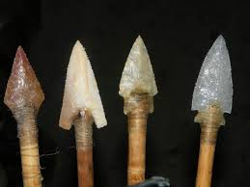
Stone Age Tools

Slide 2
Why might people in the Stone Age have needed
tools and weapons?
What would they be used
for?

Slide 3
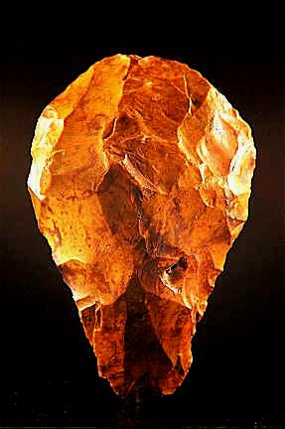
In the Palaeolithic period, or early stone age, humans developed great skill at fashioning beautiful tools such as hand axes.
People were nomadic hunter-gatherers who probably made tools on the spot to skin and butcher large game.

Slide 4
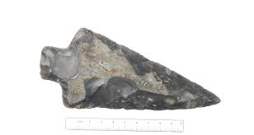
How our ancestors made Stone Age tools.
*Early in human evolution people discovered that stone could be used to make tools.
*They found that flint, which is similar to a
diamond in hardness, fractures easily to give
razor sharp edges.

Slide 5
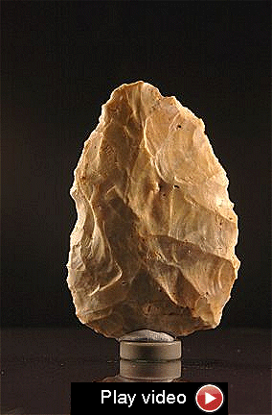
Later, in the Mesolithic or
middle stone age, still
nomadic, people
developed skills at making
flake tools that could be
mounted in a wooden
shaft to make arrows or
spears and the first
purpose-designed
carpentry tools like the
Tranchet adze.

Slide 6
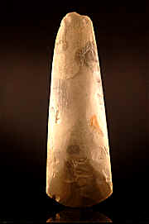
In the Neolithic or new stone
age, people began to live in
agricultural settlements. They
had time to make intricately
flaked tools such as scythes
and polished axes.

Slide 7
The processes they used left distinctive marks on
the tools they made.
If you get a suitable large piece of flint (called a core) and
strike it near the edge with a round pebble, called a
hammer stone, you will break off a flint flake.
In the palaeolithic period this technique was used to chip
flakes away, leaving the core as the tool.
In the Mesolithic, this process was commonly reversed
large flakes were chipped away to make scrapers and
cutting tools and the core was discarded.

Slide 8
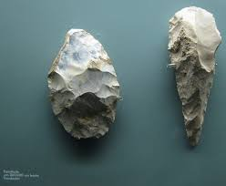

Slide 9
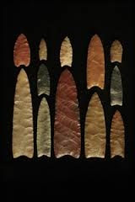
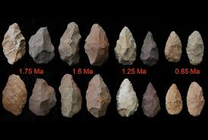

Slide 10
